Slide 1
Midterm Prep
CIS 305

Slide 2
Deployment models
public -- implemented over the public internet
private -- within the enterprise's own firewall (even VPC fits this definition)
hybrid -- combined public/private
community -- related organizations fund/support cloud
VPC -- virtual private cloud

Slide 3
Service models
Infrastructure as a service -- VMs with associated storage and network on which you land your own apps
Platform as a service -- single offering, possibly of multi-tier design with space to build and deploy apps
Software as a service -- buy units of an existing application (minimal configuration)
Everything as a service -- a way of looking at delivery of IT "services"
As an example of overlap and complexity:
delivery of database operations may be a part of DBaaS, or of PaaS
Example of extension of service modeling:
delivery of VoiP, VPN, PBX, unified communication in a cloud -- CaaS, communication as a service

Slide 4
NIST attributes of cloud
Self-service
Pooled resources
Broad network accessibility
Metered
Elastic

Slide 5
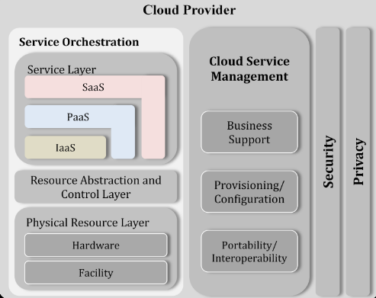
Major parts of the NIST conceptual model for cloud providers:
Cloud Service Management
Security
Privacy
Service orchestration

Slide 6
NIST subdivisions of "service orchestration":
Service layer
Abstraction and control layer
Physical resource layer

Slide 7
NIST cloud service provider:
Cloud service providers are the entities responsible for making a service available to interested parties.
The service “provider" may sub-contract parts of delivery.
For example: a SaaS provider may run their service on a PaaS which is provided by a third-party, and that PaaS may run their platform service on a "fourth"-party. But the consumer does business with the SaaS provider only.
Sometimes referred to as the service “owner.”

Slide 8
Cloud components (provided internally as services)
Image store -- a catalog and repository for virtual machine images
Controller node -- schedules & manages (orchestrates) deployment of VMs -- uses a message bus and APIs for communication -- day-to-day administrative tasks
Compute node -- deploys VMs via its hypervisor
Storage -- both boot drives and added storage (or serverless storage)
Network -- security from other tenants, communication within tenant-defined groupings
Identity -- provide login and authorization for functions
Dashboard -- a "single pane of glass" for viewing usage, cost, performance, events

Slide 9
Storage focused:
The purposes of RAID are --
Make data highly available
Improve data access performance
Increase security/fidelity of data
What device is used primarily for off-site storage of backup data?
The most high-performance storage device (no moving parts)?
Most flexible of physical storage configurations?
Notes:
high availability -- mirror
data access -- stripe
fidelity/security (in the sense of no data loss) -- parity

Slide 10
Network focused:
A cloud network can be virtual (all running in software), or physical (where virtualization front-ends hardware), or a combination of both.
The chief hardware elements that can be used to enable the network used by a cloud are all the usual suspects:
load balancers
routers
switches
cables
firewalls (and other security HW)
network cards

Slide 11
Elements of Virtualization used in cloud
Hypervisor
Virtual compute (virtual machines; cpu, memory)
templates -- guest os
Virtualized network (routers, switches, firewalls)
frequently its own capability in a virtual machine -- like vyatta/vyos (CIS 116) can also just use the built-in switch (like in kvm) or add a virtual layer to a physical switch
Virtualized storage
using SAN, or NAS/NFS, and minimal DAS (maybe for boot-able OS)
All of these are examples of (physical) resource abstraction and pooling

Slide 12
The most commonly supported hypervisors are:
ESXi (from VMware)
Xen (from Citrix)
KVM (open source)
HyperV (from MS) -- would like to be added to this list. It has some support.

Slide 13
Consolidation
The practice of migrating from physical servers to virtual machines (whether cloud or not cloud).
Efforts should be made to improve the ratio of VMs to physical machine beyond 1 VM to 1 physical machine -- thus improving the utilization of the physical machine.
Most physical server vendors can provide an estimated consolidation ratio for an idealized workload (if you really press them for one).
Consolidation ratio can be a key driver for a business considering move to a virtual environment (including cloud).

Slide 14
Consolidation -- deciding what to migrate first
Sometimes you will not have a choice of what systems to migrate, but if you do:
non-mission critical systems
pre-production systems
development
test/quality assurance
infrequently used system (monthly/quarterly)
simple applications that don't require many modifications to operate in cloud
The cloud provider should apply a heavy use of metrics on first systems moved and apply what is learned to subsequent migrations.

Slide 15
Most commonly used mgt protocol
When managing systems that make up a cloud, you will use the same protocol you used for accessing your Google Cloud Platform systems (on a good day).
What is that secure protocol?
Notes:
SSH

Slide 16
Name benefits of cloud computing
Network isolation is built-in (supports multi-tenant design)
Infrastructure consolidation is encouraged (the benefits of virtualization)
Self-service (happier customers)
Speed of IT delivery (happier IT [and customers])
Growth patterns thought out in advance
Permits IT to focus on enterprise objectives, not just technology delivery

Slide 17
Logistics
You will be provided with an access code Thursday
The test will be available until 12:01AM Saturday
There are 40 questions
It is limited to 120 minutes
Most are multiple choice, but also fill in the blank, and T/F

